Slide 1


Language is communicating ☺
You’ve chosen a language ☺ Hurray!
National 5

Slide 2
L’objectif:
i) to be able to discuss reasons for studying a language ii) to learn about the languages course at National 5
True or False
Languages have existed since about 100,000 BC
Currently there are now more than 6000 languages spoken in the world
Only 6% of the world’s population speak English as a first language
75% of the world’s population don’t speak any English at all
ALL OF THE ABOVE ARE TRUE!!!

Slide 3

Languages are important!

Slide 4
Why is it good to study a Spanish?
http://www.youtube.com/watch?v=-te-toPHWVQ

Slide 5
My Spanish experiences…

Slide 6

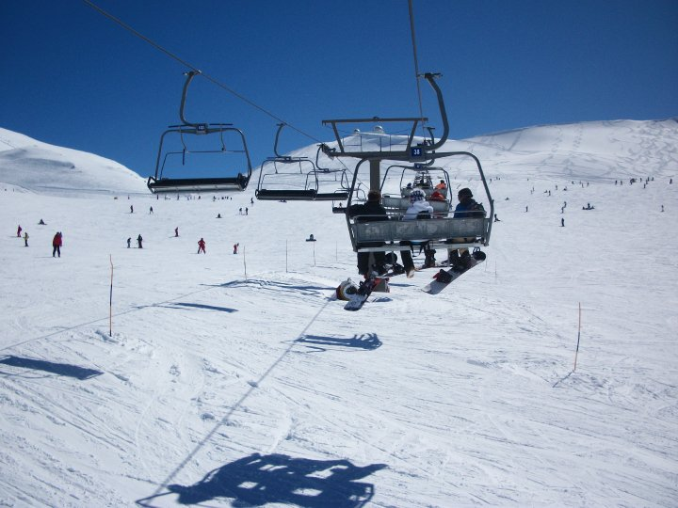







Slide 7
What is good about doing a language at National 5?
You will add an international dimension to your choice of subjects at this stage which only 30% of students in the UK have and most of them go to private schools!

Slide 8
You will create greater opportunities for yourself to work abroad, or for companies in the UK with international links. Many employers look for people who speak a foreign language.

Slide 9
You will learn about the countries where the language is spoken and get a lot more out of a trip there.

Slide 10
You will learn many skills which are useful in a wide range of future careers, such as the ability to communicate clearly, being confident about speaking in public, using problem-solving strategies, etc.

Slide 11


During the course you will work on two Units which you must pass assessments in.
1. Understanding Language
This is about your ability to READ AND LISTEN to written and spoken French OR Spanish.
2. Using Language
This is about your ability to TALK and WRITE in French or Spanish.
You will do assessments for these Units throughout the year in class time when you are ready, marked by your teacher.
We will keep a bank of EVIDENCE to show that you have passed the units.

Slide 12
AT NATIONAL 5 you will also sit EXTERNAL EXAMS at the end of the year
READING (30%) LISTENING(20%)
TALKING (30%) WRITING (20%)
You will read three texts in the modern language. You will respond to questions in English by using English. You may use a dictionary.
You will listen to one monologue and one short conversation in the modern language. You will answer questions in English and respond in English.
You will produce one written text in the form of a job application email. This is supported by six bullet points (4 of which you will know beforehand) which you must address. You may use a dictionary.
You will deliver a presentation on a topic you have studied and you will take part in a natural, conversation with your teacher.

Slide 13
How can I succeed in the reading and listening exams?
Concentrate on all listening and reading activities done in class – you will build exam skills without even realising it.
Learn vocabulary on a weekly basis to make sure it sticks in your long-term memory ready to pop up when you need it in an exam. There is too much too learn if you leave it until a week before the exam!
Read/listen as much in the language as you can online – you will be given some good websites!

Slide 14
How can I succeed in the speaking assessments?
Practise your pronunciation and accent whenever you can (no-one can hear you in the shower!).
Record yourself on your Ipod and listen over and over again.
Practise with someone else and make sure you test yourself.
Know all your key past/present/future verbs and structures off by heart so that you feel confident.
Be able to give a variety of opinions and reason

Slide 15
How can I succeed in the writing assessments?
Know a variation of key vocabulary and spellings and don’t rely too much on the dictionary
Know all your key past/present/future verbs and structures off by heart so that you feel confident.
Know your key grammar points.
Use your notes well!

Slide 16

Work hard and enjoy your learning!

